Slide 1
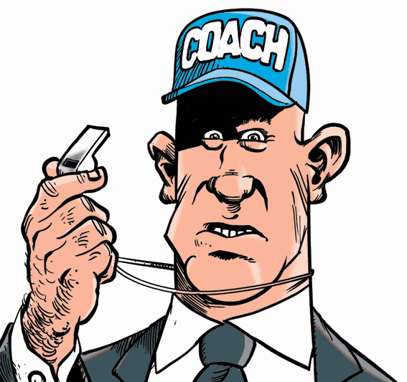
The Business Aspects of Coaching

Slide 2
Managing Relationships
Athletic/School Administrators
-Understanding Professional Relationships
-Organizational Skills
-Effective Communication Skills
-Accountability

Slide 3
Keep Your Athletic Director Informed and Up-To-Date
Avoid putting your athletic director in a situation where he or she is caught off-guard.
Anything that you send out to parents, athletes, media should also go through your athletic director.
Invite your athletic director to all events:
Contests
Meetings
Banquets

Slide 4
Coaching Duties Pre-Season
CPR/First Aid and AED training
Equipment Inspection (field & facilities)
Conditioning/Wt. training (sport specific)
Pre-season meeting (informative)
Physicals
Emergency cards
Pre/Post test
Practice schedules/scrimmages/games
Goals and expectations
Team Rules
Reporting Injuries (Athletic Trainer) Chain of command
Documentation

Slide 5
Pre-Season Procedures
Pre-Season Procedures
This begins as soon as your season ends.
Be organized and ready!
Don’t put things off!
Set the example – It’s the easiest way to gain or lose the trust and faith of your athletes, parents and colleagues!
Remember: Everyone is watching YOU!

Slide 6
Pre-Season Procedures
Pre-Season Procedures
Arrangement and Announcement of Physical Exams
Know and follow your school’s policies and procedures
Physicals
Who, Where, When and What forms are required
Rechecks
Injury Reports
Eligibility

Slide 7
Pre-Season Procedures
Pre-Season Procedures
Spread the Word!
Inform Your Athletes
Inform the Parents
Phone Calls
Letters Home
Signs Posted In Your School
Local Newspapers
Booster Club Meetings
Community Events

Slide 8
Pre-Season Procedures
Pre-Season Procedures
Rules and Regulations with permission slips and instructions to parents outlining expectations and all documents that are required and necessary.
“FAILURE TO WARN”
Avoid the headaches!
Expect the unexpected!
Be prepared for anything and have a plan in place beforehand so that you are ready to deal with absolutely anything!

Slide 9
District Policies
Know Your School District’s Policies and Procedures
Do you have a grade policy?
Do you have an athletic participation policy?
Does it coincide with an academic or school/community conduct policy?
Do you have a Code-of-Conduct?
School Conduct
Drugs/Alcohol Consumption
Conduct out in the Community

Slide 10
Coaching Staff
Head Coach is program administrator
Create meaningful roles for assistants and give them responsibilities for some aspect of the program
Help train and educate assistants
Maintain positive/respectful relationships with opposing coaches and opponents
Enjoy the competition

Slide 11
Role of Assistant Coaches
EARN YOUR STRIPES – Leaders earn the right to lead, because they manifest character and integrity and they get results!
Assistants must share the philosophy and attitudes of the head coach
“If an assistant coach doesn’t buy into your philosophy, one of you won’t be there for long.”
Roy Thompson, Basketball Coach

Slide 12
Role of Assistant coaches
Assistant coaches should be part of the decision making process
Assistant coaches must support the decisions of the head coach and they must be positive role models for the athletes.
“Work hard, stay focused and surround yourself with good people.”
Tom Osborne, Nebraska Football Coach

Slide 13
Role of Assistant Coaches
Get Staff Involved
Preseason Jobs
Planning for the upcoming season (playbook, handbook, rules, plays, goals, etc.)
Planning Practices
Game Day Duties
Don’t try to handle everything yourself – It may result in doing just an average job at everything – Strive for excellence everywhere!
Know who your kids respond to the best in order to get the desired action and outcome!

Slide 14
Player Organization
Captains Counsel
School Code of Conduct p. 119
Publish, post and sign to indicate understanding awareness for parents and athletes
Examine various Codes to develop an ideal model
Recommended resource: NYSPHSAA “Developing Successful Codes” Program
Accountability/Violations/Consequences p. 120
Indefinite suspension
Team suspensions and student rights/Due Process
Remediation Considerations

Slide 15
Player Management
Involve team in establishing acceptable/unacceptable behavior standards
Teach and continually reinforce appropriate, respectful behavior standards toward opposing coaches, players, officials and spectators
Acceptance of Diversity
Model and demonstrate good sportsmanship behaviors
Hazing and Sexual Harassment – refer to school policy for hazing and sexual harassment (see addendum 2)

Slide 16
Coaching Parents
Helping parents understand their role to support their child and the team
Parental guidelines establishing parameters of acceptable behavior during the season
Appropriate time when dealing with conflict and concerns
“Cool off ” period- next day, not after game
Schedule a meeting through athletic administrator
Extend appreciation for their support

Slide 17
Coaching Parents/Spectators
Work with athletic administration to foster positive spectatorship
Plan with athletic administrator to provide proper management plan
Coach should model expected behavior reflective of the student-athletes mission
Reinforce with the student body appropriate expectations for group behavior through pep rallies, physical education classes, assemblies, etc.
Encourage appropriate relationships with cheerleading squads to promote a positive and supportive environment

Slide 18
Sportsmanship
School District plan is a necessity
NYSPHSAA Sportsmanship Guide p.70
NYSPHSAA Citizenship through Athletics
NYSPHSAA Good Sports Program
NYSPHSAA Hazing Identification and Prevention Workshop
Section and League Guidelines

Slide 19
Successful Coaching
Wears many hats….
Builds relationships…students, parents, teachers, staff, administration, community members.
Athletic venue = extension of the classroom
Program produces “winners”
Lifelong skills and relationships
People come first.
Life is work so enjoy it.

Slide 20
Pre-Season Media Duties
Press Releases
Pre-Season Press Release
School (address, phone numbers)
Athletic Director
Administrators
Returning Players
Last Year’s Highlights
Milestones (Brief History of Your Program)
When and Where You Practice
Team Roster with Correct Spellings

Slide 21
Press Releases
Pre-Season Continued
Schedule of Events with Times and Locations
Indicate the Big Game or Big Rivalry
Coaching Staff
Names
Phone Numbers
Include Information About Major Events – If they don’t know about it, then they can’t cover it!
Sectionals
States

Slide 22
Coaching Duties during the Season
1. Maintain inventory of equipment and supplies
2. Communications with media
3. Reports on all injuries - follow school policies and procedures
4. Prepare league reports – eligibility lists if required, selection classification reports
5. Prepare reports requested by athletic director
6. Rating of officials
7. Sportsmanship reports

Slide 23
Coaching/Team Meetings
The Value of Meetings
ALWAYS assure that your meetings have a purpose – don’t waste people’s time!
Preseason, In Season and Post Season
Daily Contact during the season. Make sure that everyone knows exactly what’s going on with the team.
Get feedback, ideas, suggestions, opinions
What’s Going Well?

Slide 24
Coaching Meetings
Meetings
What worked?
What’s not working?
Where do we need to make changes?
NEVER argue on the field or in front of your athletes!
Respect other’s opinions
Think and Reflect
Ultimately the head coach must make the final decision

Slide 25
Coaching Meetings
Meetings
When you walk out of out of your coaches’ meeting, everyone MUST be on the same page! If not address it immediately!
Remember that it takes time to put the right staff in place and get everything “clicking”!
Be organized for your meetings!
Write things down!
Summarize in writing and share!

Slide 26
Press Releases
During the Season
Be as organized before the event as possible
Create reporting forms
Fax sheets
Decide how you will be reporting the results
Decide who (coach, manager, parent) will do the reporting
Home Team Reports
Be prepared with all contact numbers if you compete out of the area

Slide 27
End of the Season Meetings with Administration
Meeting with athletic director
Reports/evaluation
Examples- see binders

Slide 28
End of Season Reports
Coaches Development Process
Maple Hill Boys Varsity Lacrosse 2015
May 31st, 2015
Goals Statement
1. To develop the athletic potential of the individual.
-This season’s goal for the individual player was to develop overall fitness and instill a desire to hustle. We had a young team this season and our goal was to strive to compensate for our lack of varsity experience with effort.
-To this end the players consistently competed during practice in each drill. This helped to instill a desire to work harder and prepare for their athletic contest. Each practice consisted of a variety of conditioning drills and long distance running.
Self-Assessment- Next season I would like to incorporate more of the training exercises from Top Form in our practices.
2. To develop sportsmanship.
-The importance of sportsmanship that is expected from Maple Hill High School athletes was stressed at all times.
-The players consistently held true to the level of sportsmanship expected of them and received compliments from opposing coaches on their sportsmanship.
Self-Assessment- This is an important area and I stress this every day. I believe that our players held to the standard expected of them.
3. To develop citizenship.
-The season goal was to instill a sense of community in the players.
-The team volunteered with the Village of Castleton to clean up the village streets. The team also volunteered to help the south Schodack fire department prepare their facilities for their annual open house.
Self-Assessment- This is another important area and I believe that the players positively reflected their school. I would like to do additional events next season to continue this civic duty.
4. To foster teamwork.
-Lacrosse is a team sport and to this end working together was stressed daily. Drills consisted of partner work and small/large group activities. Point of emphasis was that we are in this together and only as a team can we succeed.
Self-Assessment- Our team worked well together and strove to be a competitive team in all of our games. I would like to continue to attend camps and clinics to further my knowledge of lacrosse in order to incorporate new ideas/drills into our practices.
5. To develop personal leadership.
-It was my goal to lead by example and be consisted with our message that we will be competitive each game, that hustled was critical to success, and that we would improve each game and play with class.
Self-Assessment- I believe that the team exhibited the above mentioned goals and that the coaches set the example for the players to follow.
6. Goal (chosen by coach, approved by athletic director).
-Goal- The Maple Hill Boys Varsity Lacrosse team will be competitive in each game, display proper sportsmanship and show improvement in each game.
List the ways you plan to develop and strengthen your program.
Summer lacrosse leagues for returning players.
Top Form summer program.
Fall lacrosse & tournaments.
Winter lacrosse leagues.
Review of Performance. (Athletic Director)
Coach’s Signature ______________________
Athletic Director’s Signature ______________________
Date ___________________

Slide 29
Press Release end of Season
End-of-Season
Always Prepare a final year end press release with highlights
Sectional Winners
Sectional Place Finishers
Team Accomplishments
School Records
Post Season Recognition
All-Stars
Sportsmanship
Academic Awards

Slide 30
End of Season Recognition
Bulletin Boards
Posters
Announcements
Letters
Awards
Pep Rallies
New Traditions
Perpetual Plaques

Slide 31
Budgeting

Slide 32
Coach as the Businessman
Budgeting (prioritize)
Purchasing (quality bids)
Record Keeping (awards, records, injuries..)
Maintenance of equipment (3 year cycle)
Collecting and reconditioning equipment
Last competition or scheduled meeting
100% accountable for all equipment
Check out form beginning of season
Check out form end of season

Slide 33
Positive Coaching = Positive Budgets
Positive coaching can influence your budget
As a coach we are “on stage”
What we do and say influences parents, players & community
Positive coaching affects the overall program- players, parents & community

Slide 34
Represent your program in a positive manner-go the extra yard
---------- Forwarded message ---------- From: Sprague, Brian P. <BrianP.Sprague@energizer.com> Date: Wed, Apr 23, 2014 at 8:25 AM Subject: Lacrosse Game To: "mbubniak@schodack.k12.ny.us" <mbubniak@schodack.k12.ny.us> Cc: "marquartm@hoosickfallscsd.org" <marquartm@hoosickfallscsd.org> Mark,
My name is Brian Sprague and I am an assistant lacrosse coach with Hoosick Falls program. On behalf of HFCS we want to thank you and your staff as well as the school for hosting yesterday’s game. Your school by far was the most hospitable and respectable team we have played. As soon as we got off the bus we were greeted by a player (#9) and shown the bathroom/ locker room to change. After leaving the locker room and stepping onto the field we were greeted by the head coach Kyle Randall who is a true gentleman. During the game all players remained in control and played hard. After the game the parents were generous enough to cook some hot dogs and provide some water. I only wish the weather good have been better so that we could have mingled with the players and coaches at the end. I can only say that this is a reflection of the community, school and children and you all should be proud of.
Sincerely,
Brian Sprague

Slide 35
Community Service & School Budgets

Slide 36
Booster Clubs and Support Groups
“Parents as Partners”
Establishing parameters and assign duties
Fundraising and booster clubs
Role of the booster club
Coaches role in the booster club

Slide 37
Positive Public Relations = Positive Budgets
Don’t ever forget how important this actually is!
Media
Community
Youth Groups
Rotary Clubs, etc.
Booster Clubs
School Based Groups

Slide 38
Youth Program
Role of the youth group in the program
Fundraising
Coaches role in the youth program-youth clinics/camps
High School coaches-coaching youth teams
Positive youth program
Connection between youth program & high school program

Slide 39
Youth Summer Camp
Wildcat Lacrosse Camp Program 2014
June 23 – June 27, 2014
Maple Hill Lacrosse Foundation will be holding an evening Summer Youth Camp that will allow players to continue to learn and develop the fundamental skills required for the sport of lacrosse. This will be accomplished through individual skill development, team drills, and game play. All aspects of the game of lacrosse will be taught including face offs, ground balls, passing and catching, shooting, offensive and defensive strategies, and goal tending. The program will be run by coaches of the Maple Hill Varsity Lacrosse Team and other guest coaches. All Coaches are volunteers and all camp fees go directly towards supporting the Maple Hill Varsity Lacrosse Team.
Camp will run each night from 6:00 – 8:00 pm. Registration is open to students who will be entering grades 3 through 10 of the Schodack School District and surrounding communities; new players are welcome to attend.
Full safety gear is required. Campers must be registered members of US Lacrosse. US Lacrosse Memberships can be done at USLacrosse.org. Cost for the program is $50.00 per registrant. Payment and completed paperwork required prior to registrant participation. Checks made out to Maple Hill Lacrosse Foundation & consent to treat forms can be mailed to MHL Foundation P.O. Box 65 Castleton, NY 12033 or handed in prior to start of camp. Camp will be held on the Maple Hill High School track field or Maple Hill Middle School soccer field.
Questions can be directed to Kyle Randall email: randallky@egcsd.org or phone 331-3498
­­­­­­­­­­­­­­­­­­­­­­­­­­­­­­­
Player Name___________________________DOB_______________Entering Grade________
Parent/Guardian Name_____________________________Relationship___________________
Address______________________________________________________________________
Home Phone________________Cell__________________email_________________________
In case of emergency contact_____________________________________________________
Prior MHYL participant Yes / No US Lacrosse member Yes / No
Registration fee_________________
Participation Consent: I give permission for my child to participate in the Maple Hill Lacrosse Camp Program for the dates and times specified above. I understand that in order to participate in the Maple Hill Lacrosse Camp, my child needs to be registered with US Lacrosse. I verify that I fully understand and accept that the conditions required to be registered with US Lacrosse and Maple Hill Youth Lacrosse is the same.
Guardian name (print) _________________________________Date______________________
Signature_____________________________________________________________________
Registrar Use: USLAX Consent to Treat PIF

Slide 40
Maple Hill Lacrosse Program
Creation of program-history
Financing of program
Board presentation
Role of Maple Hill Lacrosse Foundation/Adirondack Lacrosse
See handouts

Slide 41
Record Keeping

Slide 42
End of Season Media Reports
Reports to athletic director
Media and records releases
Awards programs/Criteria for awards
Banquets
Evaluations
Recommendations

Slide 43
Recognition
Bulletin Boards
Posters
Announcements
Letters
Awards
New Traditions
Perpetual Plaques

Slide 44
Press Release
End-of-Season
Always Prepare a final year end press release with highlights
Sectional Winners
Sectional Place Finishers
Team Accomplishments
School Records
Post Season Recognition
All-Stars
Sportsmanship
Academic Awards
Scholarships

Slide 45
Purchasing, Maintenance and reconditioning of equipment/end of season

Slide 46
End of Season Equipment Needs
Establish equipment and supply needs for next season
Prepare for ordering process

Slide 47
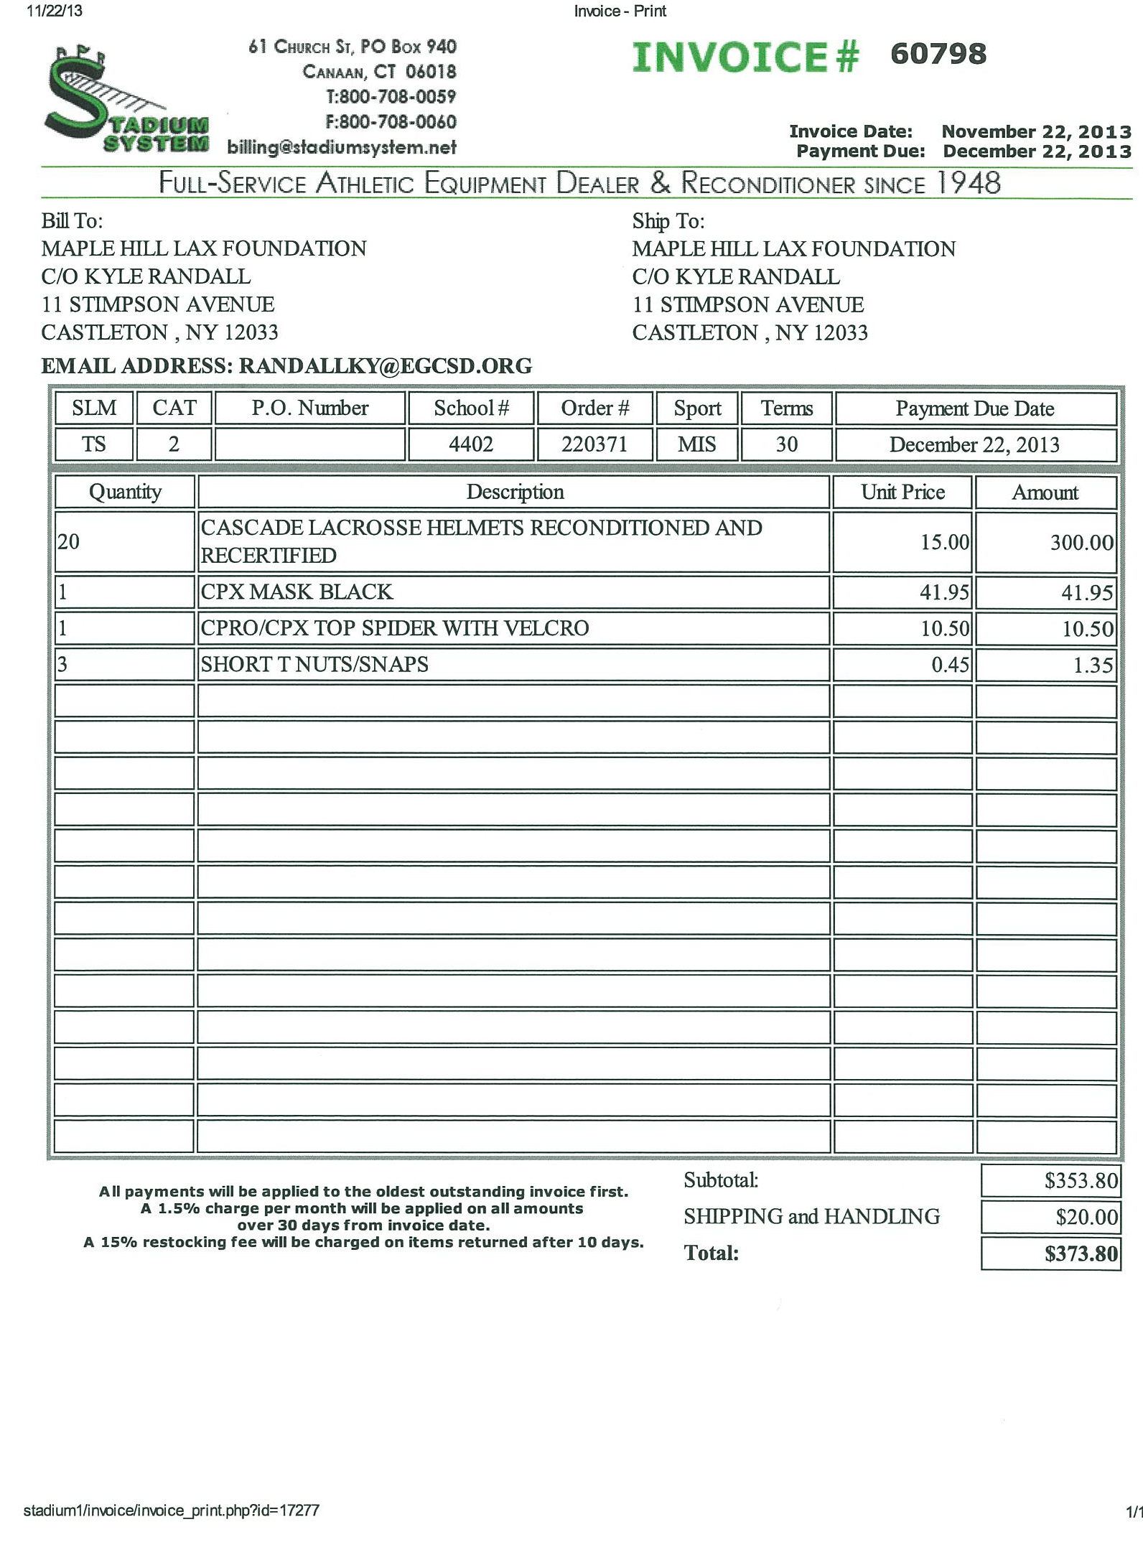

Slide 48
Equipment
Issue equipment/Sign-out forms
Collection
Care of equipment/Responsibility
Washing
Mending

Slide 49
Equipment
Have an equipment sign-out policy/procedure
Create or “borrow” an equipment sign-out and return sheet with a list of all equipment given with dates, athletes name, grade, home address, home phone number, parent(s) name and place to mark off when equipment is returned
Have the athletes sign the sheet and then keep all of the equipment sheets in a safe and accessible location

Slide 50
Inventory Equipment and Supplies
Know what you have
Know what you will need
Know your budget
How much?
What forms should you use when ordering, purchasing or requesting
Where to order
When it is due
Number of quotes necessary
No substitutions?????

Slide 51
Equipment, Ordering and Budgets
Understand the value and importance of Long Range Planning – LOOK AHEAD – What will you be needing in a year, two years, etc.
Plan Accordingly
Where can you store your equipment
Can you access it when needed?
Will it be safe
Theft
damage

Slide 52
Equipment (logistics)
Do you want to collect equipment after each event and then reassign it for the following contest?
Protect and care for your equipment but try to make your life manageable!
Does your school have a washer and dryer available for you to use?
Could you have team managers wash and handle equipment responsibilities?

Slide 53
Professional Development
Continued self improvement
NYSPHSAA Sport Specific Clinics
Workshops
Seminars
Literature
Professional organizations and memberships
NYSPHSAA and other accredited websites

